Slide 1

Yelp Review Analysis
Data Visualization final presentation
Group 6. 宋一帆 李振邦

Slide 2
01 Introduction
Clearer target & layers
Group 6. 宋一帆 李振邦

Slide 3

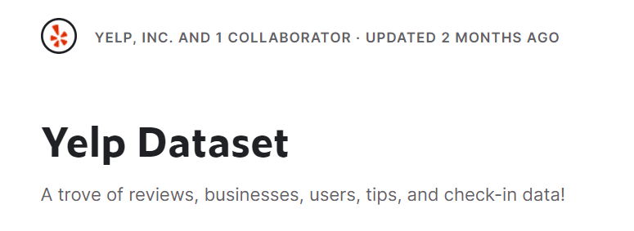
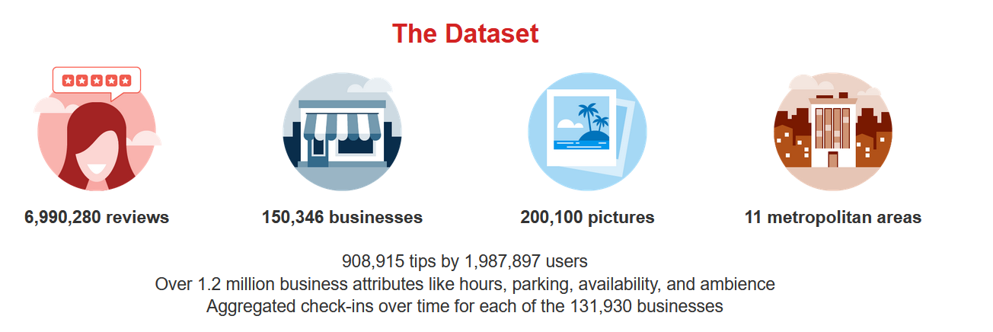
Recap: Dataset Intro
Workflow tips:
1.Kaggle kernel (found not good)
2.filters, constraints, limitations

Slide 4
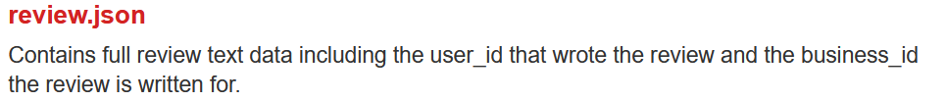
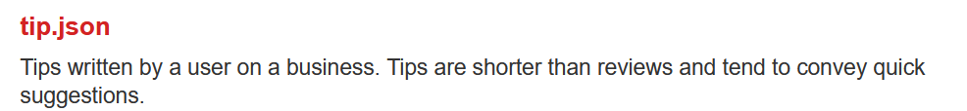
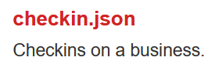
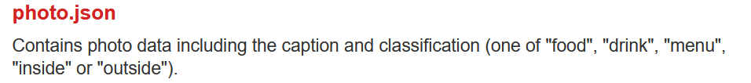
Dataset Analysis
·Yelp, Inc. is an American company that develops the Yelp.com website and the Yelp mobile app, which publish crowd-sourced reviews about businesses.
·The Yelp dataset is a subset of our businesses, reviews, and user data for use in personal, educational, and academic purposes. Available as JSON files, use it to teach students about databases, to learn NLP, or for sample production data while you learn how to make mobile apps.
Spatio
Tempe

Slide 5
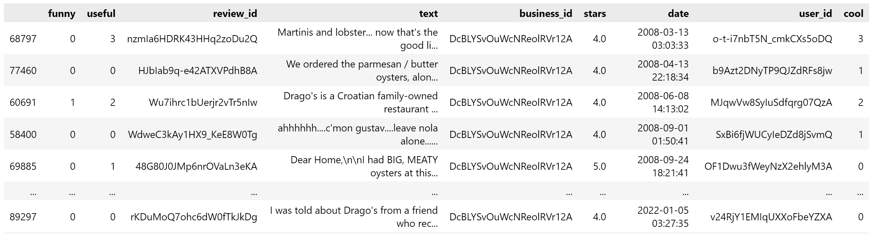
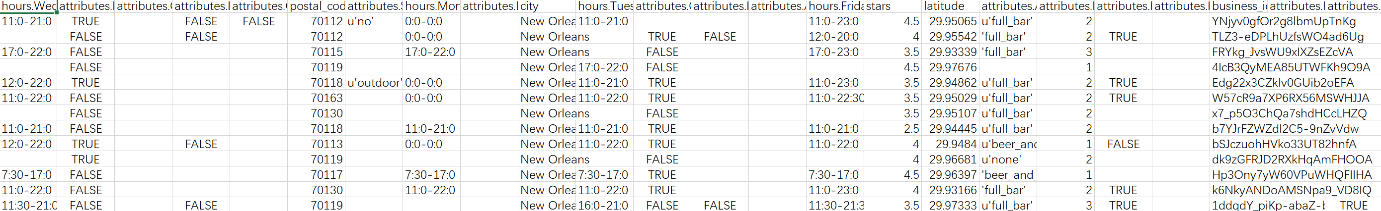
Dataset Analysis
Problem： non-standardized & high variability

Slide 6

Task: Redefine
Analysis
1.The city/area’s business components: Industry-category-style
2.Single business’s review dashboard
3.Interactive map business exploring (optional)
我们选择以个体企业为主要服务对象,帮助他们通过yelp的数据集分析自己的经营情况和同行业竞争状况
1.以其评分、收到的建议和评价制作dashboard，
2.其同行业状况：整体收到的评价、建议、同类前10的状况，制作dashboard
3.同类店家的地理分布预览

Slide 7
02 Re-design
Clearer target & layers
Group 6. 宋一帆 李振邦

Slide 8
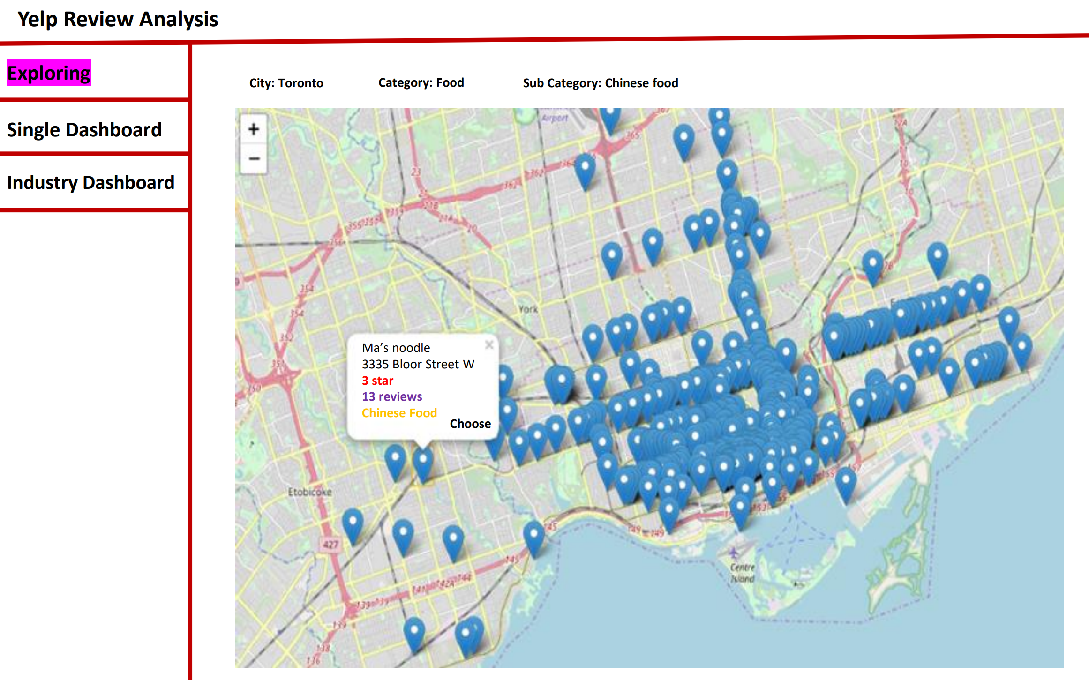
Redesign

Slide 9
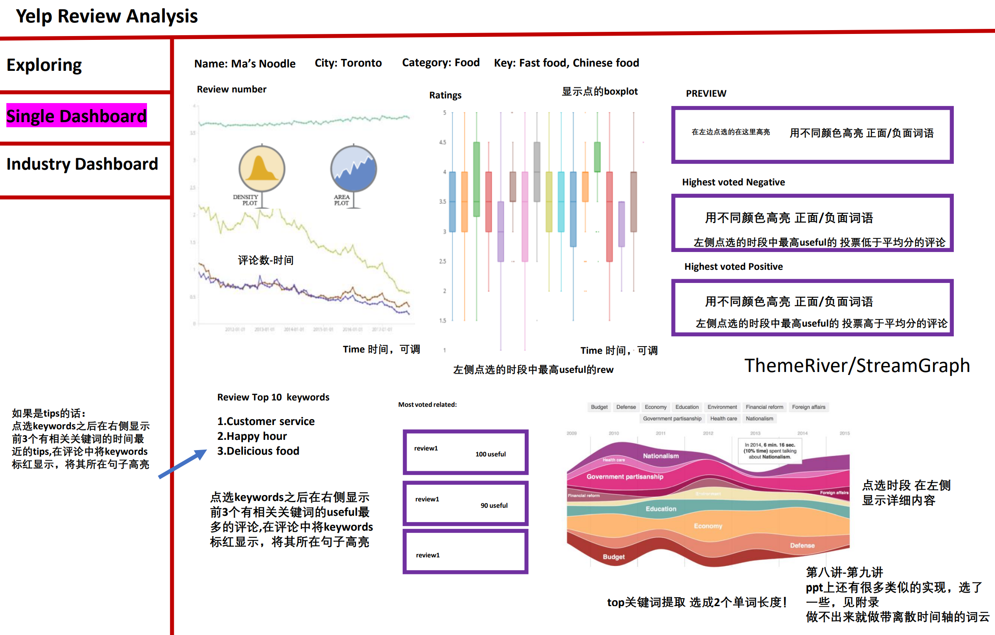
Redesign

Slide 10
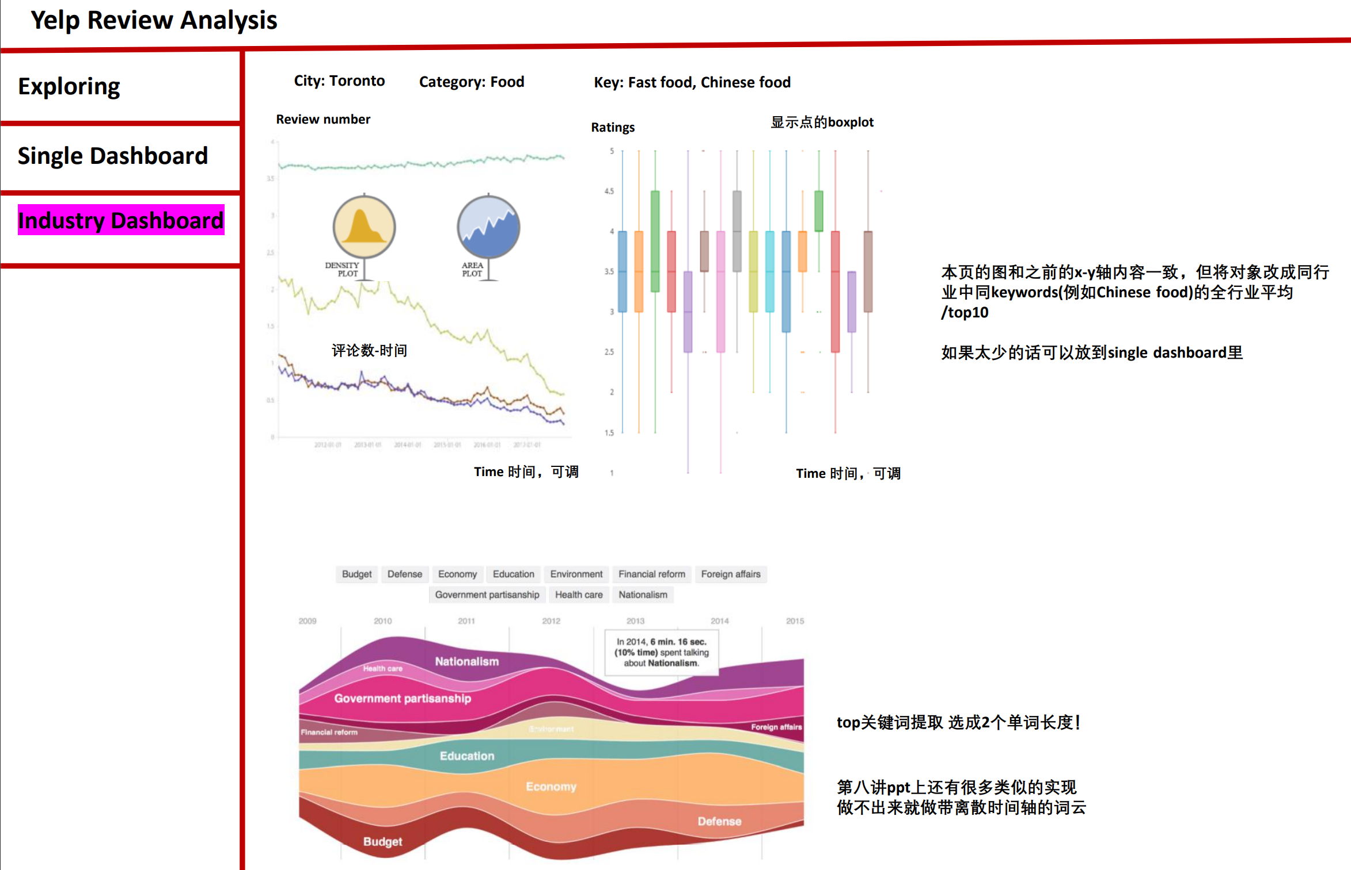
Redesign

Slide 11
03 System Build
Findings & Problems
Group 6. 宋一帆 李振邦

Slide 12
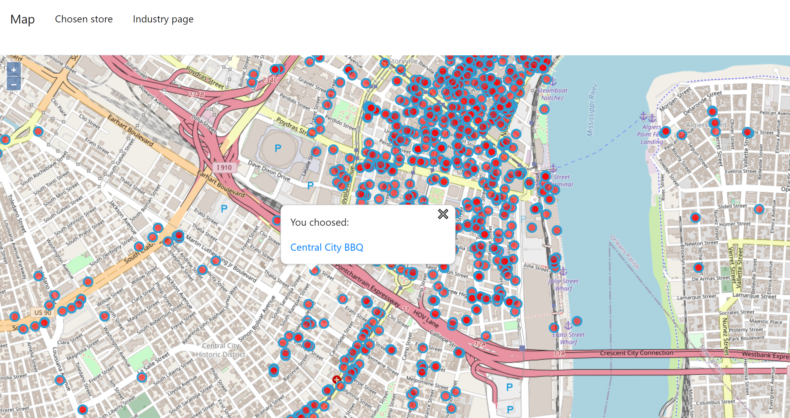

Slide 13
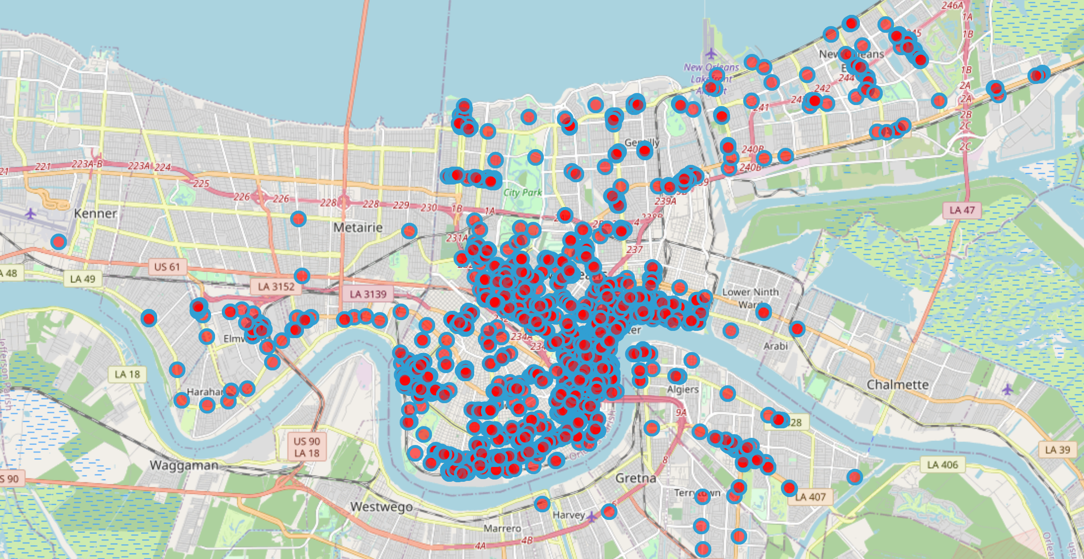
Filter Design: Find Competitors
Location /attribute/ category Filter

Slide 14
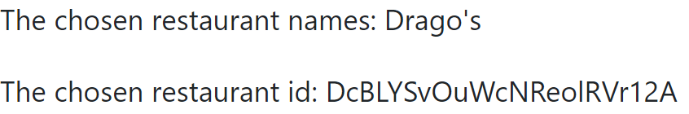
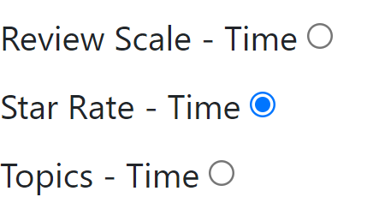
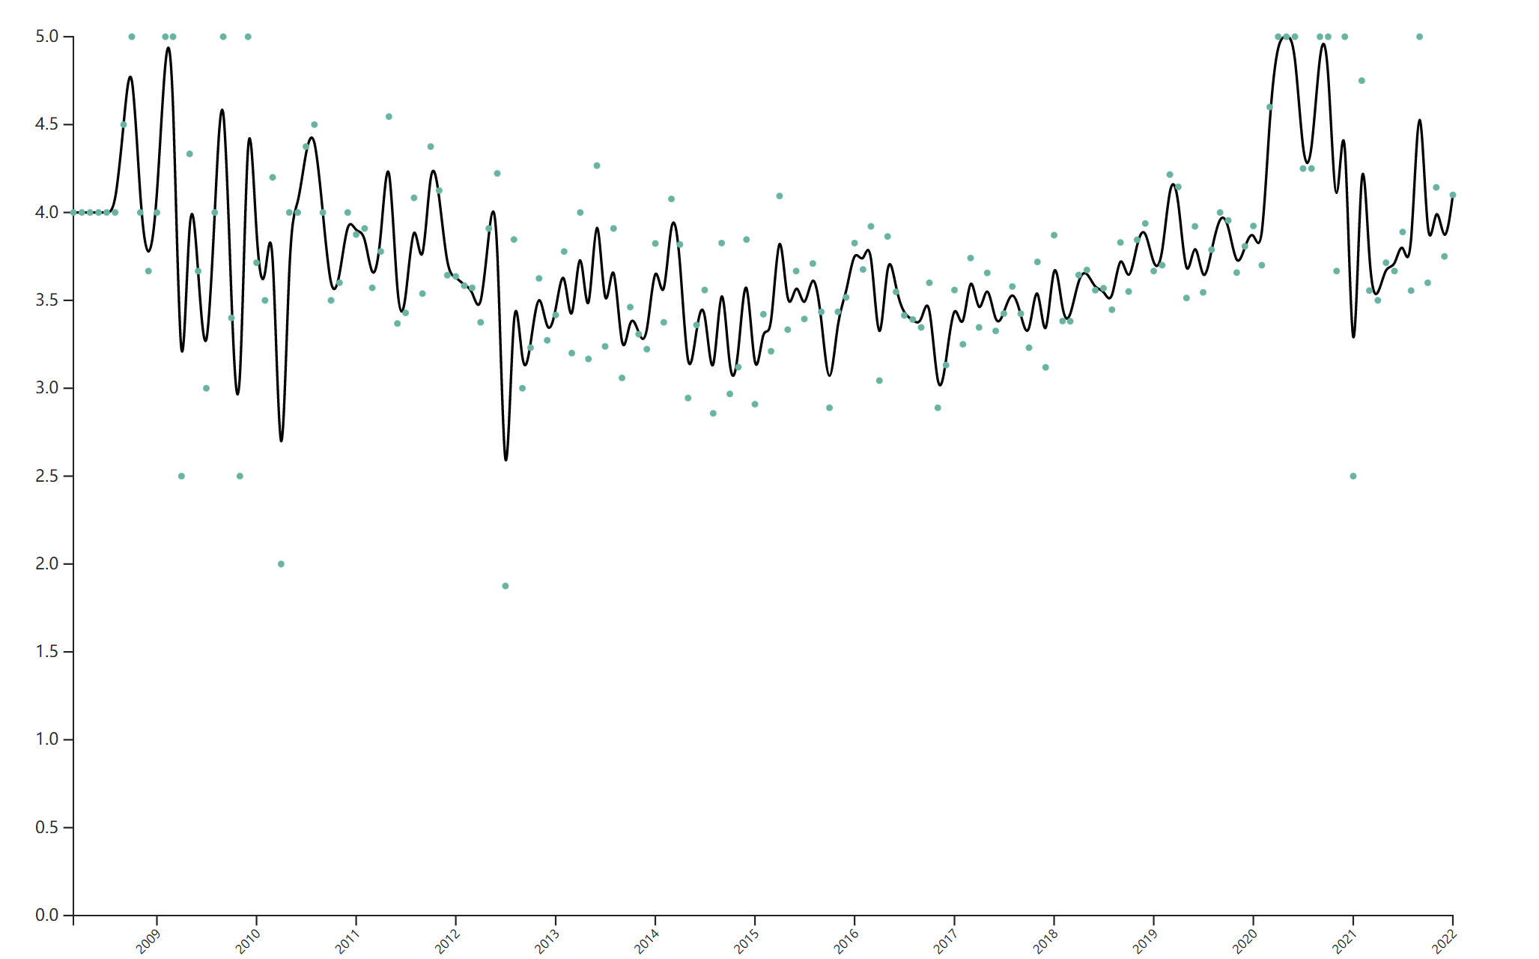
Single Dashboard
Not good:
Flexible time scale better

Slide 15
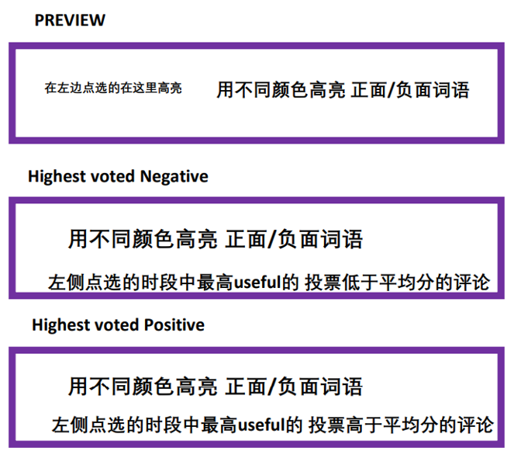
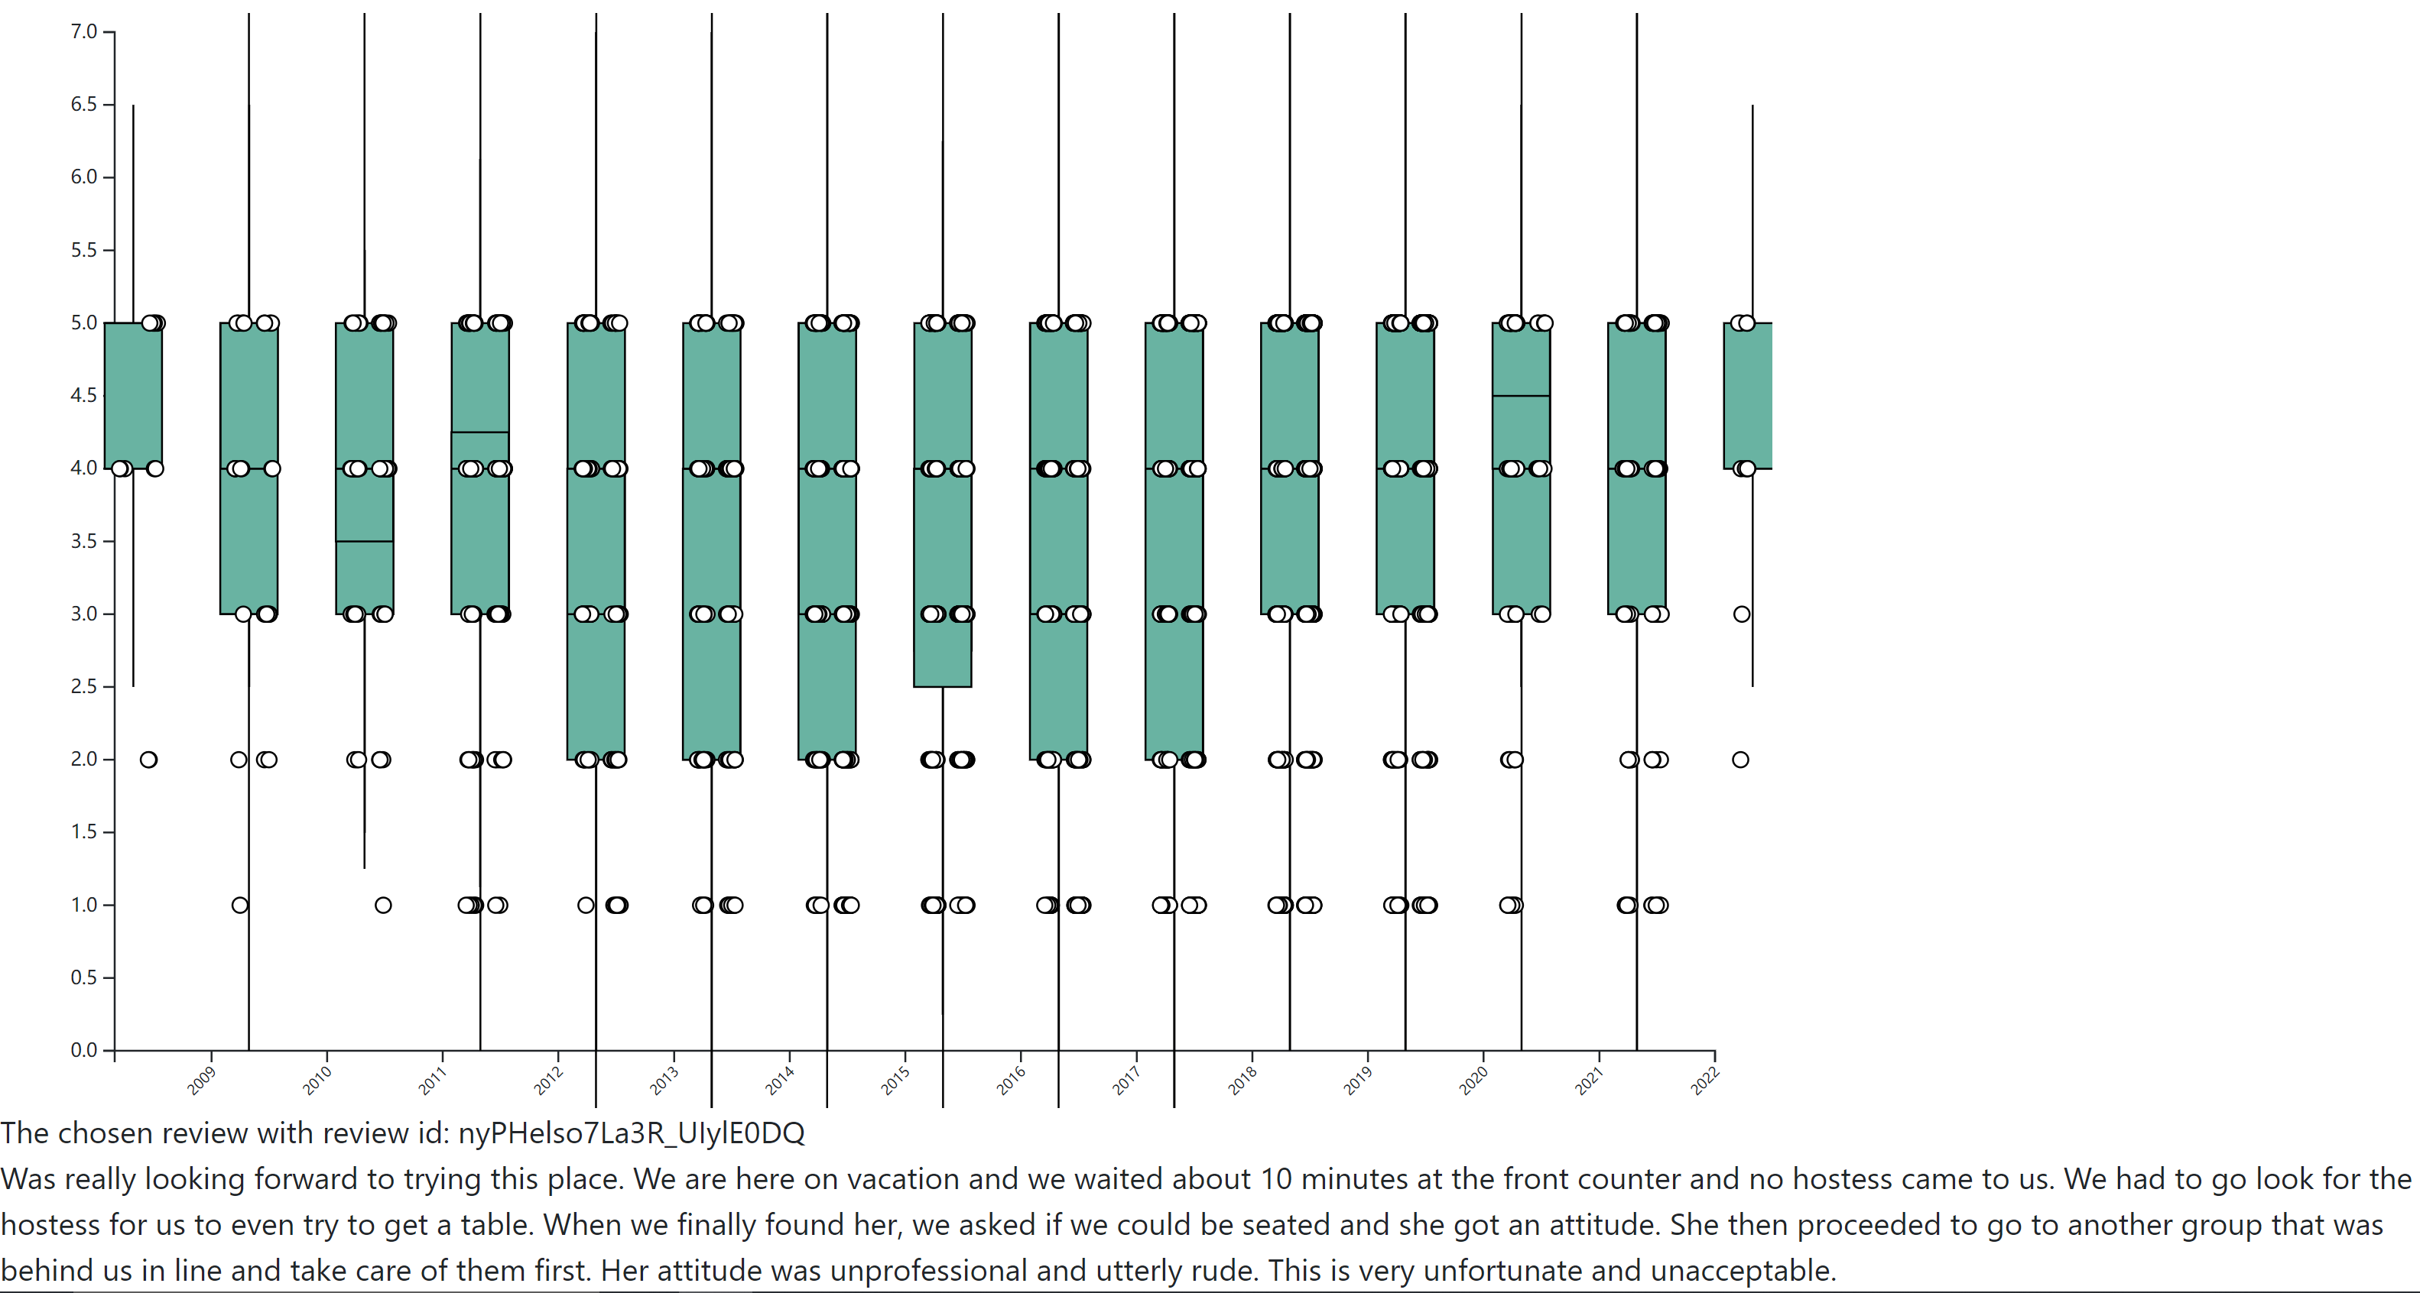
Not good:
Need to change to the season view
Displays the clicked review

Slide 16

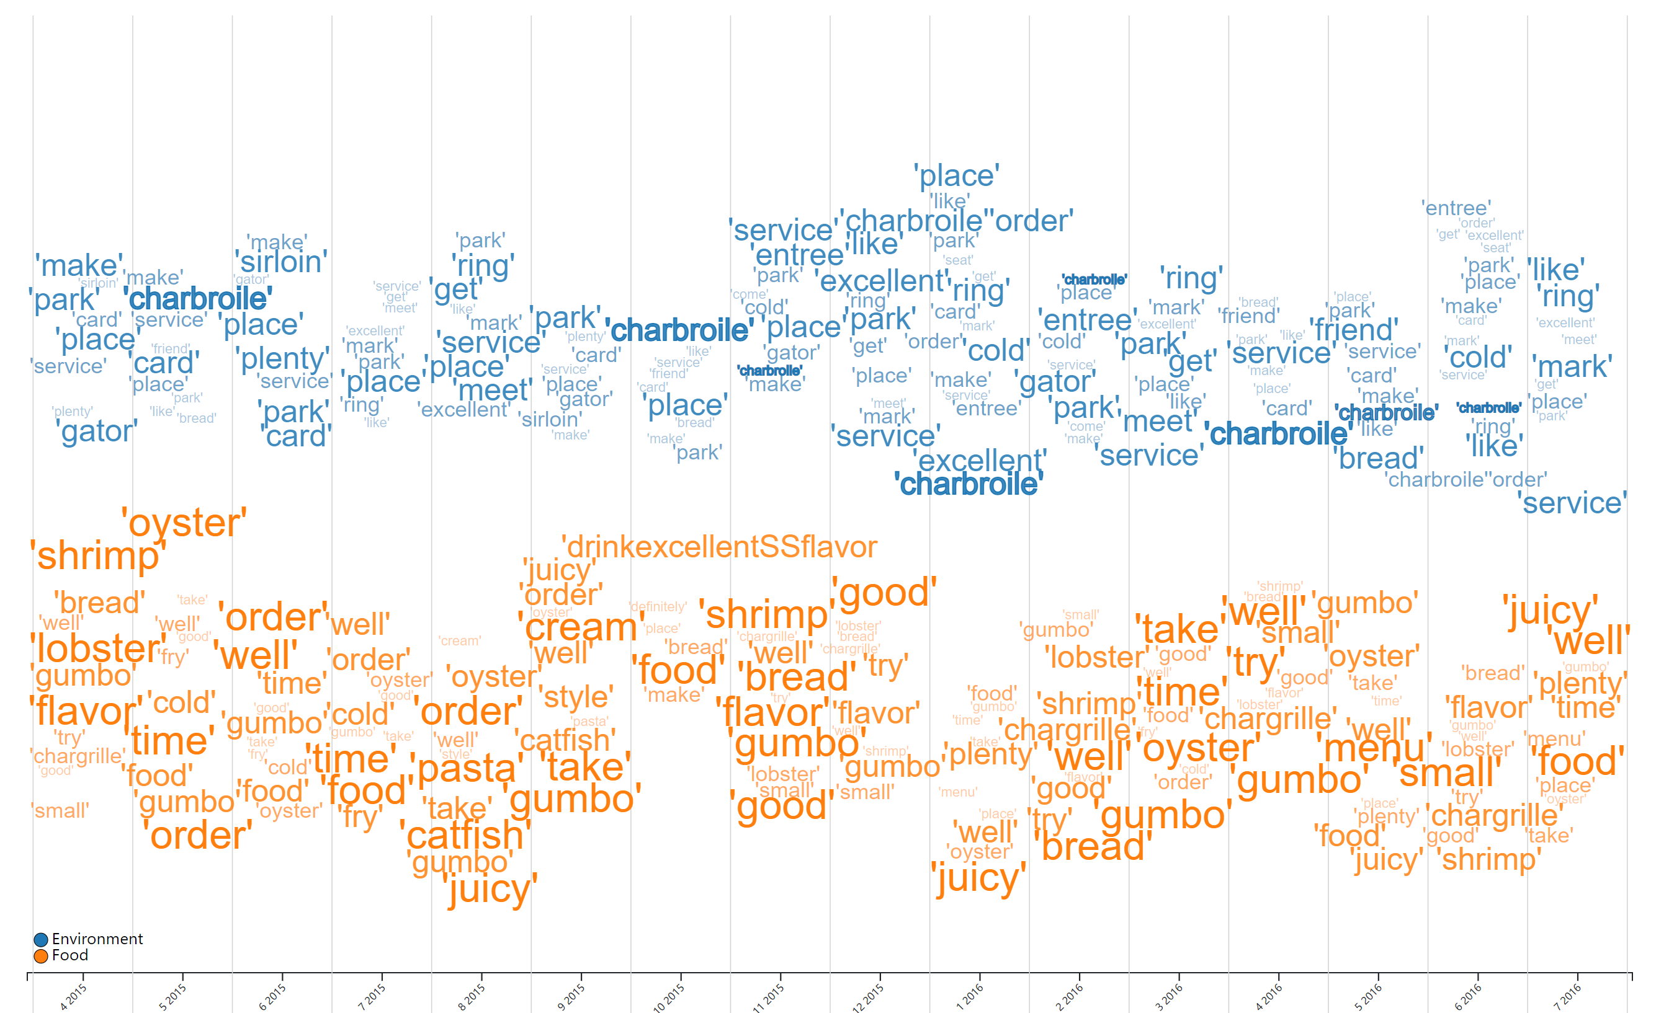

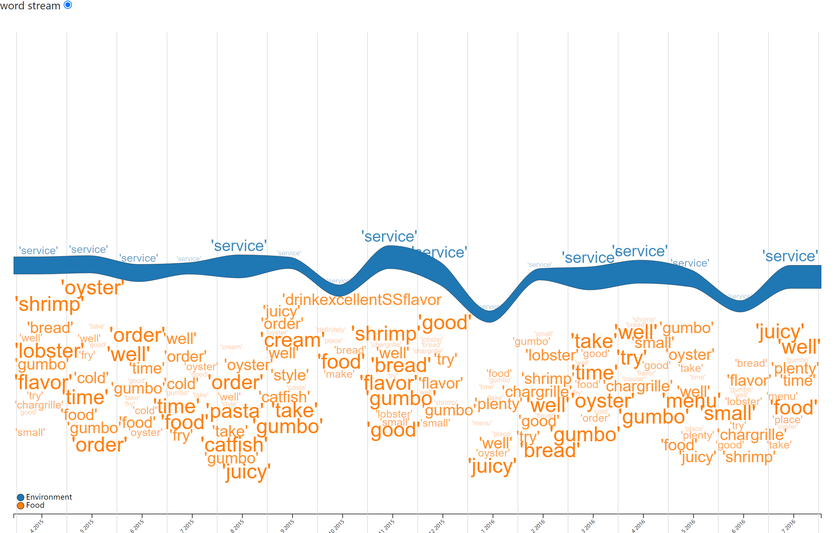
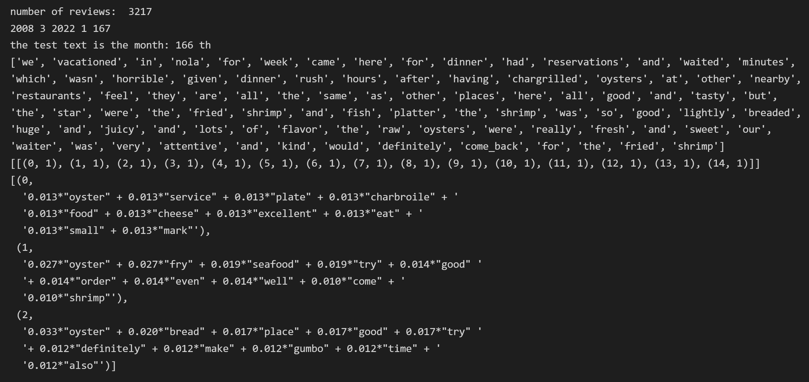
Single Dashboard
LDA
Topic Classification: Word stream
1.Customized Stopwords
2.Additional Word Cleaning
3.Customized Tokenization
Weighted & Frequency

Slide 17
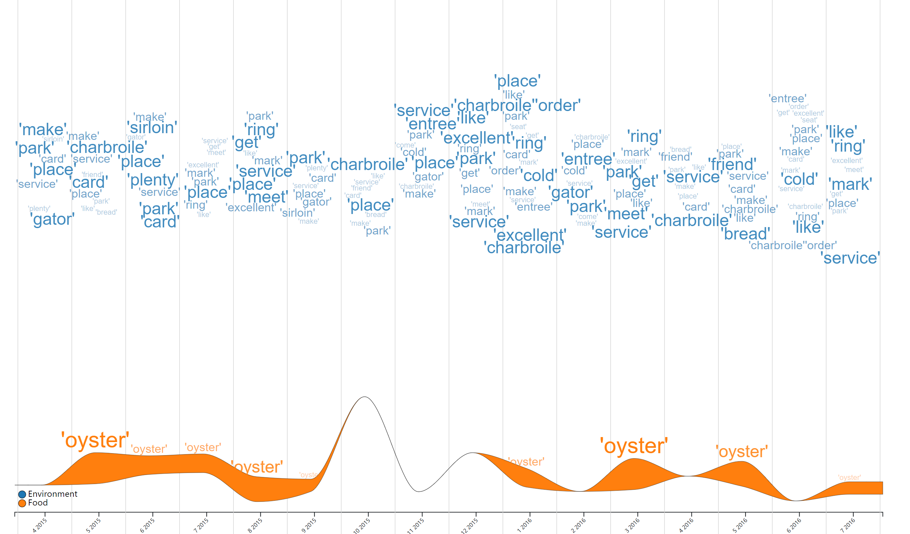
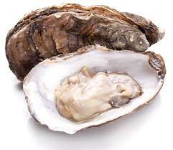
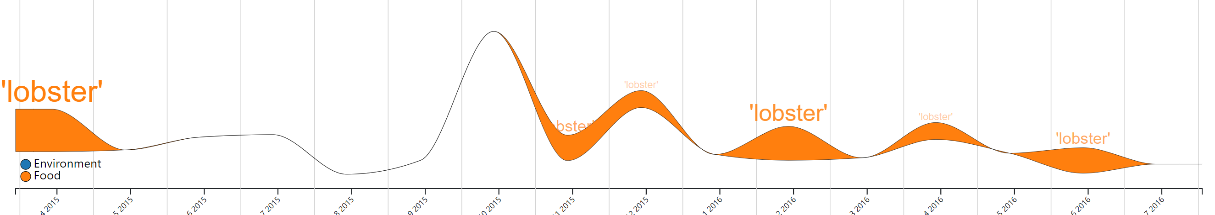
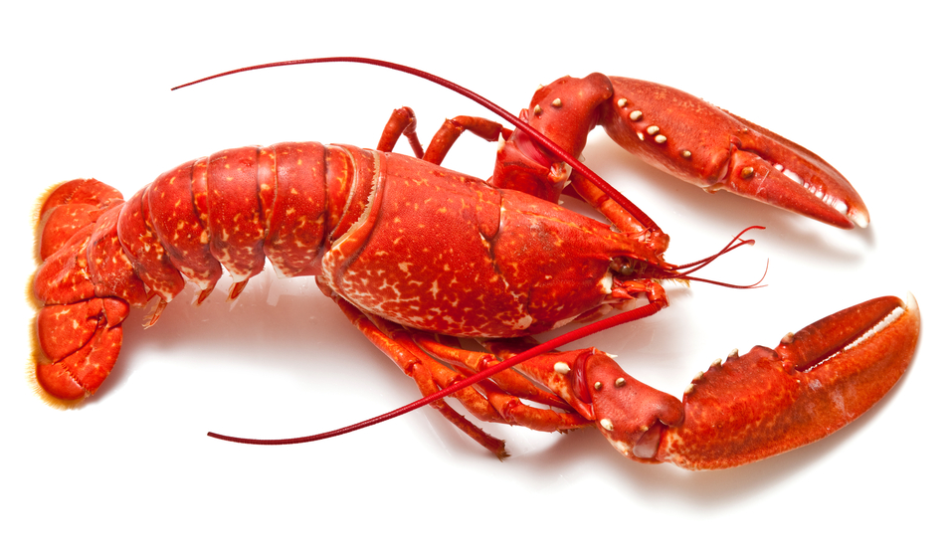
Single Dashboard
Patterns
market needs / seasonal changes
*But not good for whole industry data

Slide 18
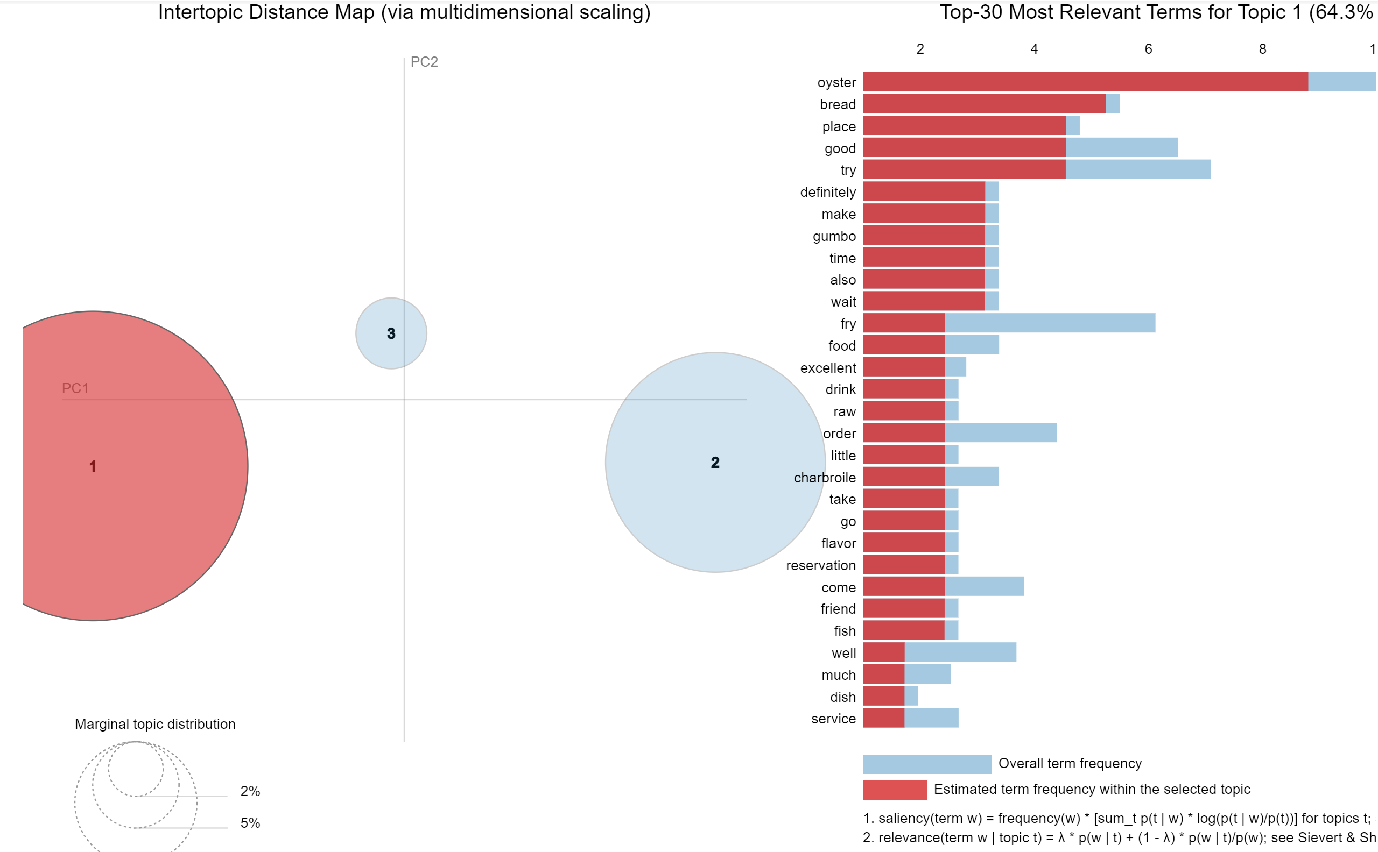
Industry dashboard: Outllooks
Our modified outlooks:
pyLDAvis. gensim_models

Slide 19
Yelp Review Analysis
Thanks!

Slide 23
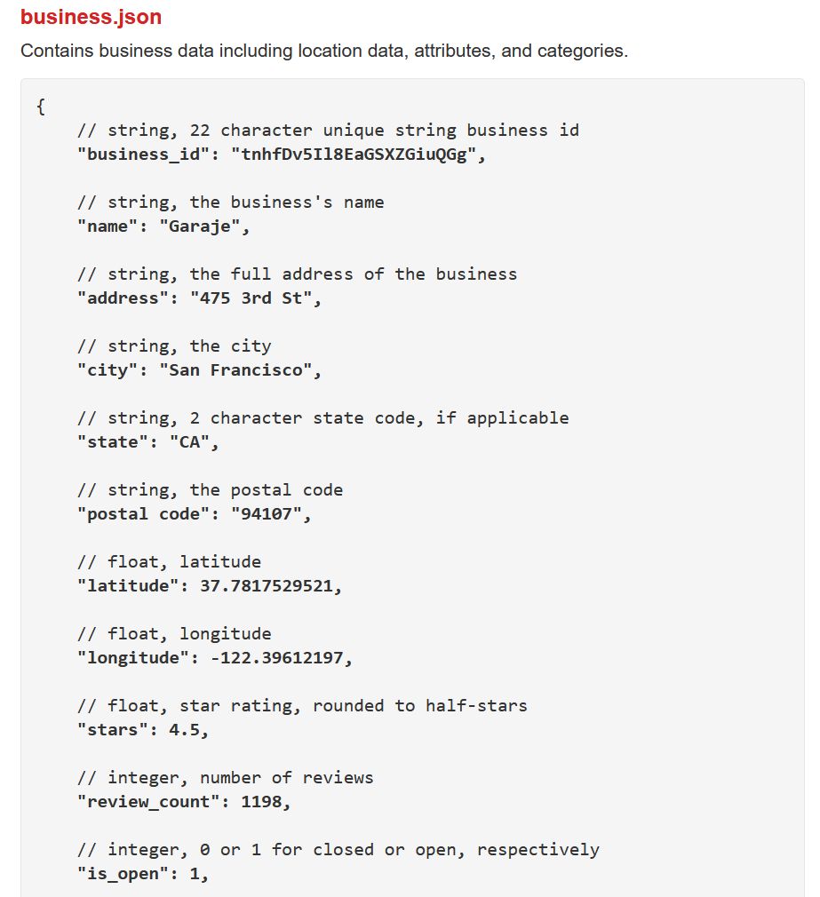
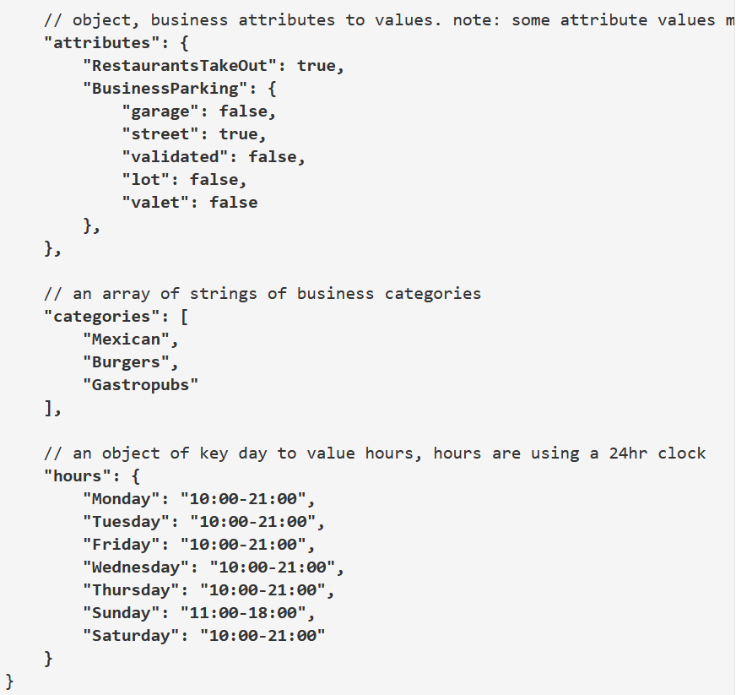
Dataset components
Blue: Identifying
Orange: Information
Purple: Filter

Slide 24
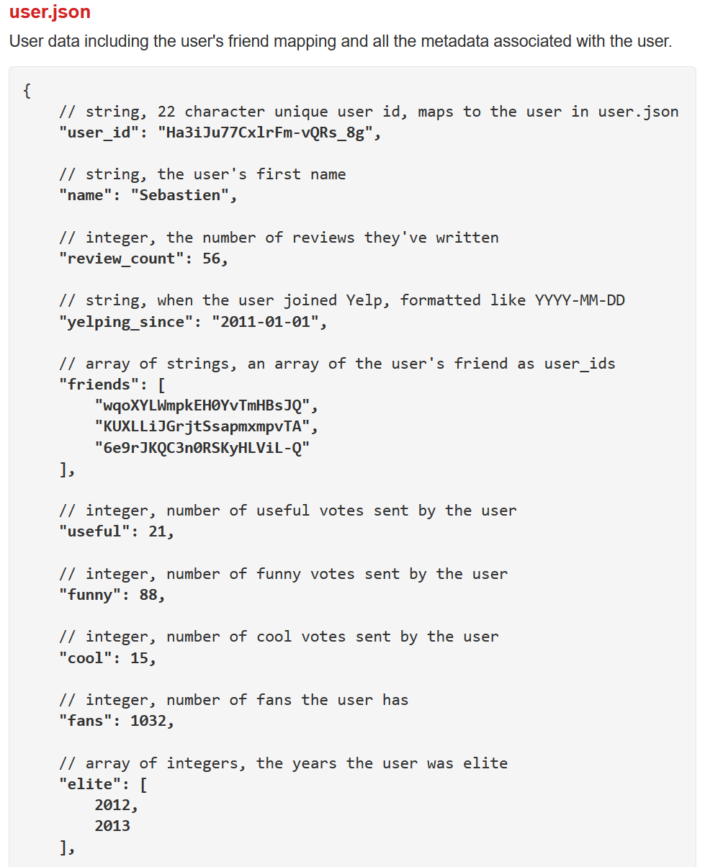
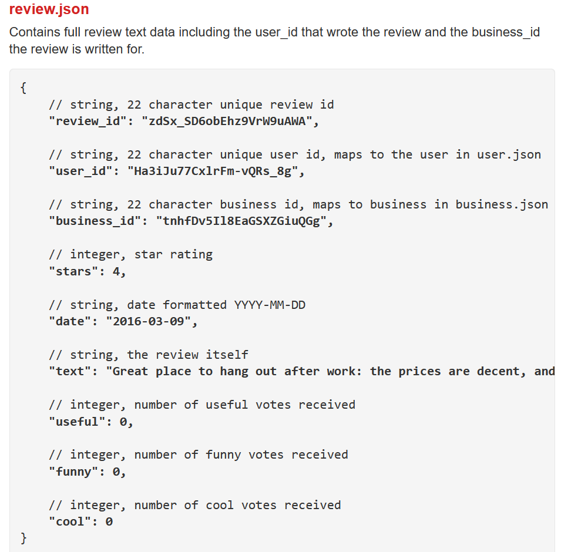
Dataset components
Special: Time-related
Blue: Identifying
Orange: Information
Purple: Filter

Slide 25
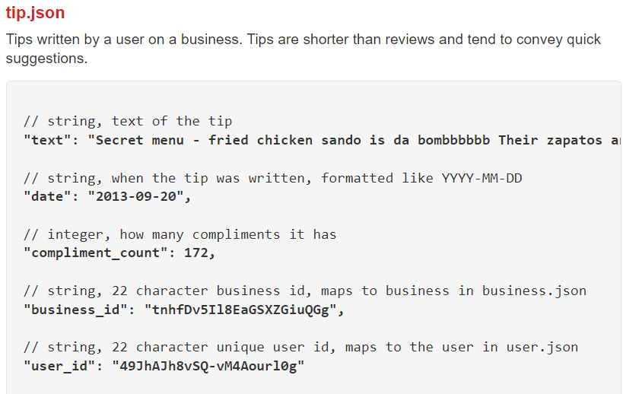
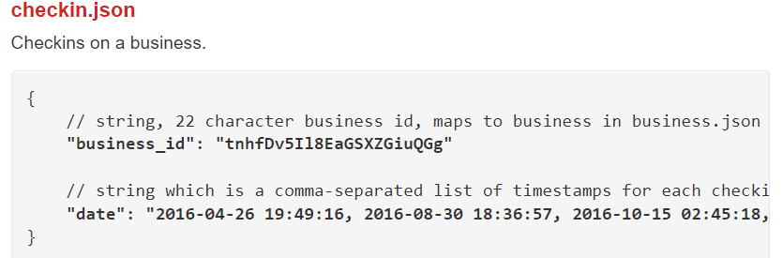
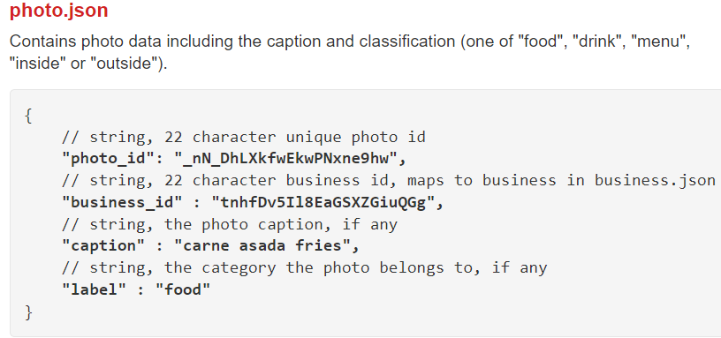
Dataset components

